Slide 1
Community Housing Programs Demystified
May 8, 2018

Slide 2
Speakers
Jennifer Levine, Housing Specialist, Commonwealth Catholic Charities
Briggitte Cordes, Housing Specialist, Saint Joseph’s Villa
Desiree Taylor, Lead Case Manager, Focused Outreach Richmond
Celie Allen, Housing Specialist, Richmond Behavioral Health Authority

Slide 3
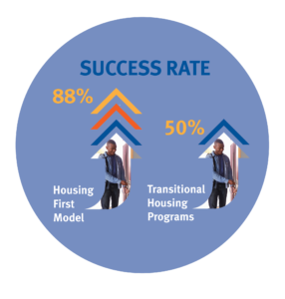
Housing First Model
HEARTH Act – Homeless Emergency Assistance and Rapid Transition to Housing Act. 2009
Most comprehensive and significant change to the McKinney-Vento Act.
Identifies a goal that people who become homeless are housed within 30 days.
Approach based on Maslow’s hierarchy of needs and prioritizes housing as the most critical needs of people experiencing homelessness.
Housing first strategies include Prevention and Diversion, Rapid Rehousing, Permanent Supportive Housing and housing-focused case management.

Slide 4
Housing Specialists – Filling the Gap
Provide housing search and supportive services to promote participants self sufficiency, integration into the community, and permanency in housing.
Serve as an ongoing liaison between property managers and participants.
Assist participants in development of a strength-based/solution-focused individualized goal and action plan that promotes permanent housing and self-sufficiency.
Richmond Housing Specialist group meets monthly.
Quarterly landlord engagement sessions.

Slide 5
Benefits for Landlords Partnering with Service Agencies
On time rent payments.
Find tenants and reduce vacancy rates.
Keep renters in their units for the long term – our goal is for tenants to be permanently housed.
Prevent costly evictions – staff regularly check-in with clients and provide case management.
Make sure tenants are good neighbors. Case managers provide access to financial counseling, employment resources and other mainstream resources. (Case managers network).
Personal satisfaction – helping someone get back on their feet.

Slide 6
Prevention Program – Commonwealth Catholic Charities
Grant from DHCD Department of Housing and Community Development.
Referrals from approved access points.
Clients who are at risk and meet other eligibility.
Up to 24 months of financial assistance.
Up to 6 months in rent arrears.
Security deposits, first month’s rent, utility deposits and payments and more – case by case.
Active participation from client is required.
Ongoing monthly case management and connecting individuals with mainstream resources for successful housing stabilization.

Slide 7
Prevention Program Rental Guidelines and Documentation
Unit must be at or below fair market rent.
Efficiency $864, 1 bed $907, 2 bed $1042, 3 bed $1386
Must meet rent reasonableness.
Must have valid lease.
One-time habitability check-list.
Lead paint visual assessment if children under age of 6 in household.
Landlord is aware of when assistance ends.

Slide 8
Rapid Rehousing Program
In 2017, over 1200 people (632 households) were rapidly rehoused in Richmond.
37% of households included children.
83% of people housed through rapid rehousing do not become homeless for at least one year.
A tailored package of assistance that may include the use of time-limited financial assistance and targeted supportive services.
Security deposit, Utility, Rent and Move-in assistance.
Typically up to 6 months or less.
Case management.

Slide 9
Rapid Rehousing
Permanent Housing for families/individuals who have lower barriers to maintaining housing stability
Timeframes for assistance vary by each agency
Agencies include:
Hanover Safe Place (Domestic Violence Survivors)
HomeAgain (Families and Single Adults)
Housing Families First (Families)
St. Joseph’s Villa (Families, Single Adults, and Youth Homeless)
Virginia Supportive Housing (SSVF for Veteran Families and Single Adults)

Slide 10
Rapid Rehousing
Unit must be at or below fair market rent.
Efficiency $864, 1 bed $907, 2 bed $1042, 3 bed $1386
Must meet rent reasonableness.
Must have valid lease.
One-time habitability check-list or Housing Quality Standards (HQS) inspection completed by the housing specialist. No wait time for the housing authority!
Lead paint visual assessment if children under age of 6 in household.
Landlord is aware of when assistance ends
Clients participate in the process

Slide 11
Housing Veterans
Local efforts to end Veteran Homelessness and reach Functional Zero
Vetlink
Veteran and non-Veteran agencies working together to identify and connect homeless veterans to services.
In 2017, 297 veterans were housed through all of the agencies working together in Vetlink.
Current goal is to house 88 homeless veterans between March 1, 2018- July 1, 2018.
Total housed so far is 26 veterans
Vetlink will need to house 22 veterans monthly to reach the goal and hit Functional Zero by Aug 2019

Slide 12
Housing Veterans
Supportive Services for Veteran Families (SSVF) through Virginia Supportive Housing provides rapid rehousing and prevention services.
Rapid Rehousing services help individuals who are currently homeless but may have fewer barriers to housing.
Can negotiate rental assistance from security deposit and first month’s rent to several months rent based on individual’s need and program’s availability.
Prevention services help individuals or families that are behind on rent that are facing eviction.
Both programs provide direct payment to landlord/property management for security deposit and monthly rent.
HQS housing inspections are completed by the housing specialist. No long wait for a housing authority.
Case management is provided to assist individuals in developing the necessary skills to prevent from late or missing rental payments.
Connection to employment, money management, and daily living skills

Slide 13
Housing Veterans
HUD-VASH is a permanent supportive housing program that is national. Locally it is assisted through Hunter Holmes McGuire VAMC.
Individuals must be homeless and disabled to qualify.
Vouchers are Section 8 Housing Choice Vouchers.
Vouchers go through VHDA or RRHA.
Housing inspections are completed through the respected agencies prior to move in.
Individuals pay 30% of income towards rent or a minimum of $50 per month. Voucher pays the rest.
Case managers at McGuire VAMC work directly with the veterans housed through the program.
Daily living skills, money management, job training, etc.

Slide 14
Housing Veterans
Focused Outreach Richmond (FOR)
Works directly with veterans and other services providers to assist with preparing veterans for housing and maintaining housing.
FOR staff continues to work with individuals once entering housing for up to six months.
FOR staff does not have direct financial assistance but they do housing search and locate housing for the veterans who may also enrolled in the Rapid Rehousing programs or HUD-VASH

Slide 15
Permanent Supportive Housing
During the January 2018 point-in-time count, 608 people were staying in PSH, a type of permanent housing that requires a disability for entry.
Typically, about 90% of PSH clients remain in their housing every year.
Approximately 58% meet the definition of being chronically homeless at entry into PSH.
59% of people in PSH are able to increase their income, most often by accessing mainstream benefits.
On average, a person in PSH has been there for over six years.

Slide 16
Permanent Supportive Housing
New state efforts through the Department of Behavioral Health and Developmental Services to reduce homelessness and provide permanent stable housing
Richmond Behavioral Health Authority started in October 2016.
85 individuals housed since October 2016
90% is still in housing
Henrico Mental Health started in November 2017
7 individuals housed so far
100% is still in housing

Slide 17
Permanent Supportive Housing
Permanent housing for families/individuals who need long-term housing that is connected to an on-going supportive services program
Agencies include:
Henrico Mental Health
HomeAgain
HUD-VASH for Veterans
Richmond Behavioral Health Authority (HomeConnect)
Virginia Supportive Housing ( Shelter + Care, A Place to Start, and Homelink)

Slide 18
Permanent Supportive Housing
Target populations (may vary from agencies). Most populations include:
Single Adults or Families (depends on agency)
Chronically Homeless
Disability (depending on the program they may have specifics for mental health, substance abuse, and or physical)
Data from homeless shelters and outreach workers assist with identifying individuals for the programs

Slide 19
Permanent Supportive Housing
Benefits of Permanent Supportive Housing
Working with a housing specialist and case managers
Housing Specialists work with the individuals to locate housing and MAINTAIN it!
A relationship with the Housing Specialist for continued support throughout residency!
Case managers provide continued support for individual’s needs.
Peer specialist may also be utilized to assist individuals with transitioning into housing.
Rental subsidy is provided. Individuals with income pay 30% of their adjusted gross income towards rent and utilities and the program covers the rest. Those without income the rental subsidy pays the entire rent and provides an utility allowance both are paid directly to the landlord and utility companies.
Yearly and monthly housing inspections are completed by housing specialists while in the program.

Slide 20
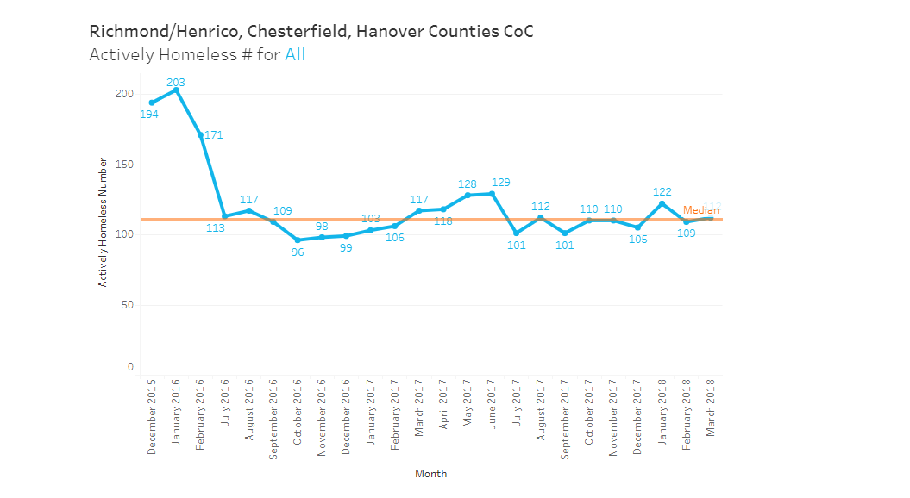
Reduction in Homelessness in Richmond with Housing Programs

Slide 21
Landlord Engagement Event June 27, 2018, 3PM – 4PM Downstairs Auditorium of Richmond Public Library 101 E. Franklin St, Richmond, VA 23219
More agency specific on programs.
Light snacks and refreshments.
Flyers on tables.

Slide 22
Contact information
Jennifer Levine, M.S. Human Services, Housing Specialist; Commonwealth Catholic Charities 511 West Grace St.; Richmond, VA 23220. Phone 804-545-5034. Fax 804-648-4931; Jennifer.levine@cccofva.org www.cccofva.org
Briggitte Cordes, CHC, HSRCC. Certified Housing Counselor, Flagler Housing and Homeless Services. St. Joseph’s Villa 8000 Brook Rd; Richmond, VA 23227. Phone: 804-553-3243; Cell 804-874-4902; Fax: 804-553-3271; bcordes@sjvmail.net
Desiree Taylor, M.S., Case Manager; Focused Outreach Richmond 400 Commerce Rd; Richmond, VA 23224. Phone: 804-510-0218; dtaylor@focusedoutreachrichmond.org
Celie Allen, MSW, Housing Specialist; Richmond Behavioral Health Authority 107 S. 5th St; Richmond, VA 23219. Cell: 804-624-0254; Fax: 804-819-4248; Cecilia.allen@rbha.org

